Slide 1

Lariat Rental Company Strategic Analysis
Alison Inglis

Slide 2



Agenda
Background & Goals for 2021
Strategies
Solutions

Slide 3
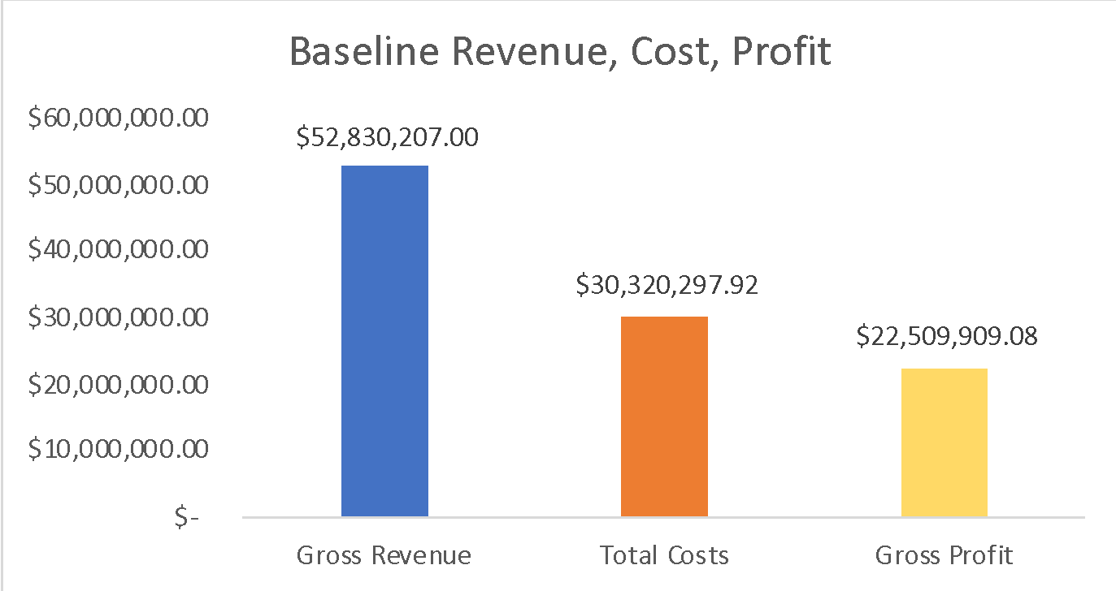
Goals for 2021
Top Goal: Grow gross profit to $30 million
Increase gross revenue
Decrease total costs
Increase profit margin
Current
Profit Margin
42.61%

Slide 4

Strategies
Strategy 1:
Grow transactions by 25% for top 10 most profitable vehicles by make and model
Strategy 2:
Increase top 10 most profitable vehicles by make and model by adding 203 extra vehicles
Eliminate bottom 10 least profitable vehicles by removing 10 vehicles
Combined Strategy
Combine Strategy 1 and 2

Slide 5
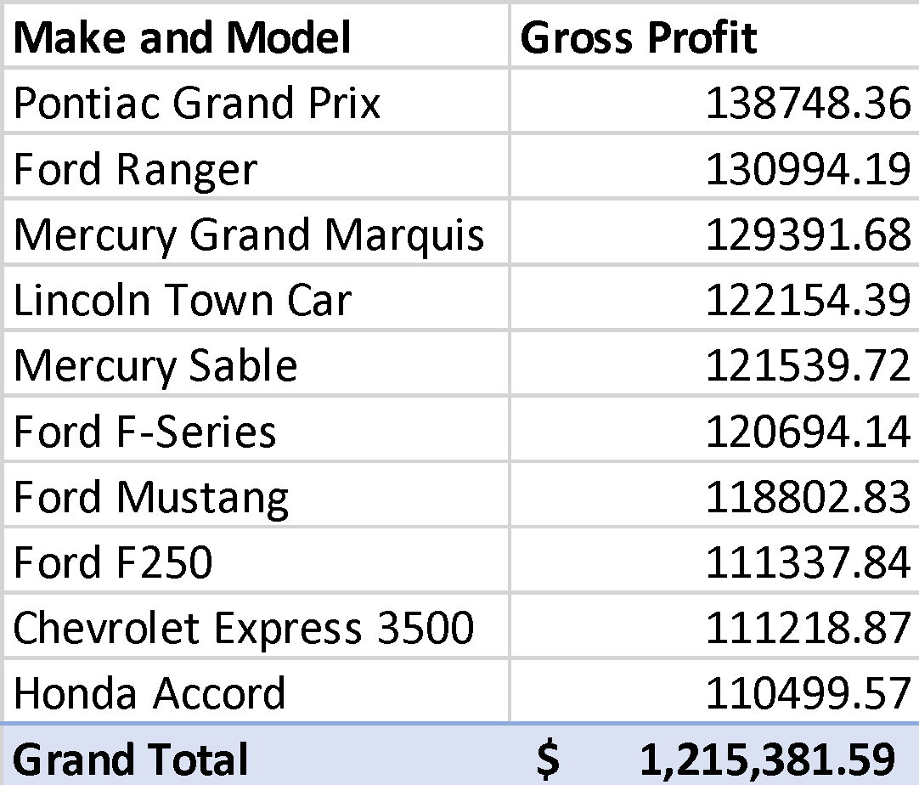
Strategies
Top 10 most profitable make and models contain 203 vehicles
Top 10 most profitable vehicles by make and model
Profit Margin 42.61%

Slide 6
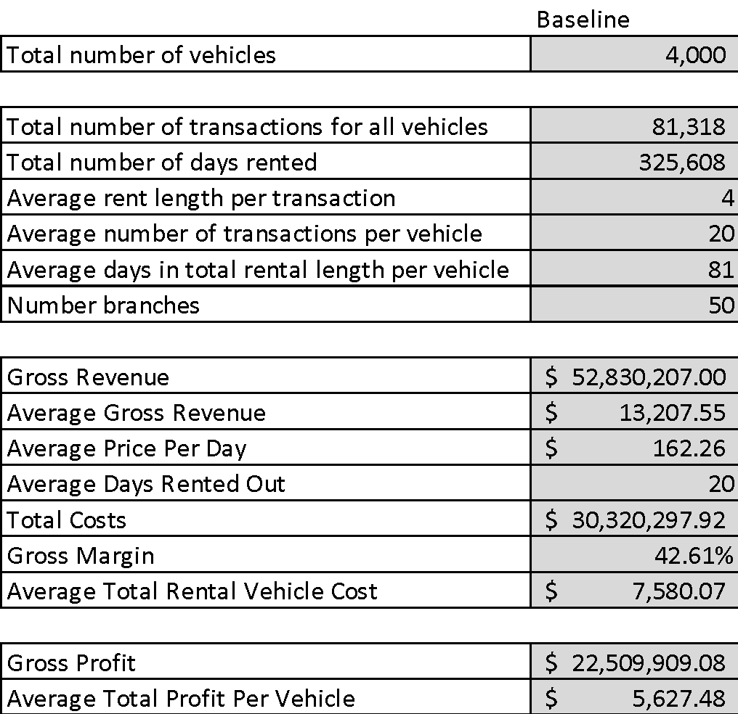
Strategies
Profit Margin 42.61%

Slide 7
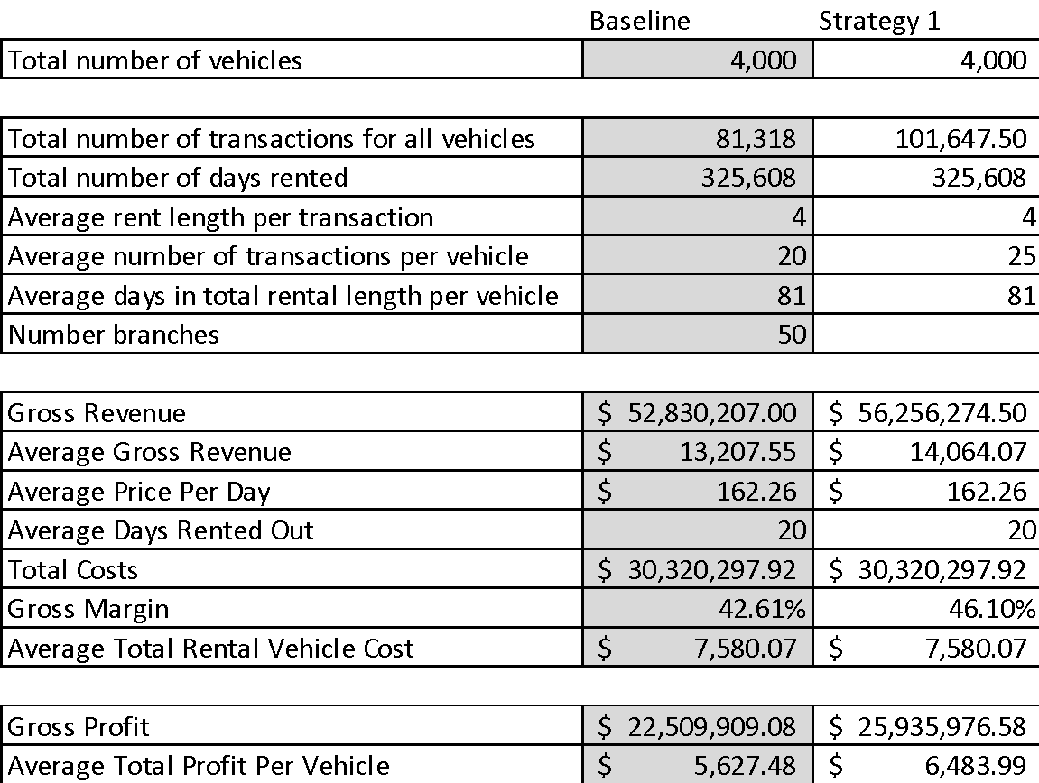
Strategies
Profit Margin 42.61%

Slide 8
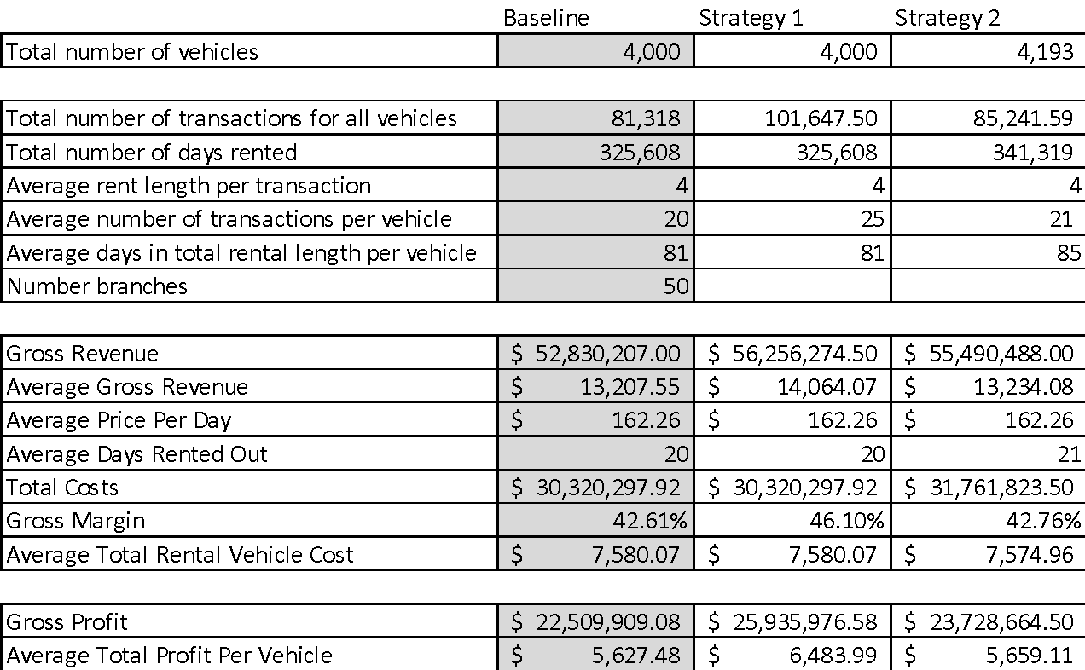
Strategies
Profit Margin 42.61%

Slide 9
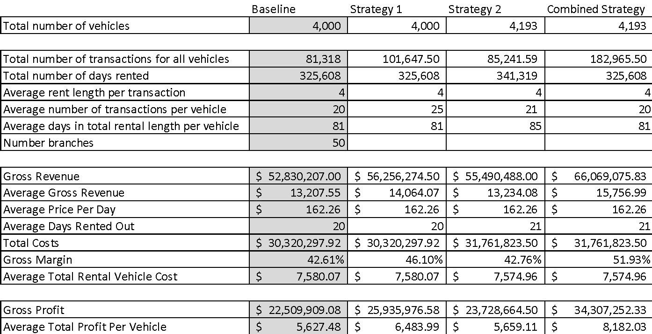
Strategies
Profit Margin 42.61%

Slide 10
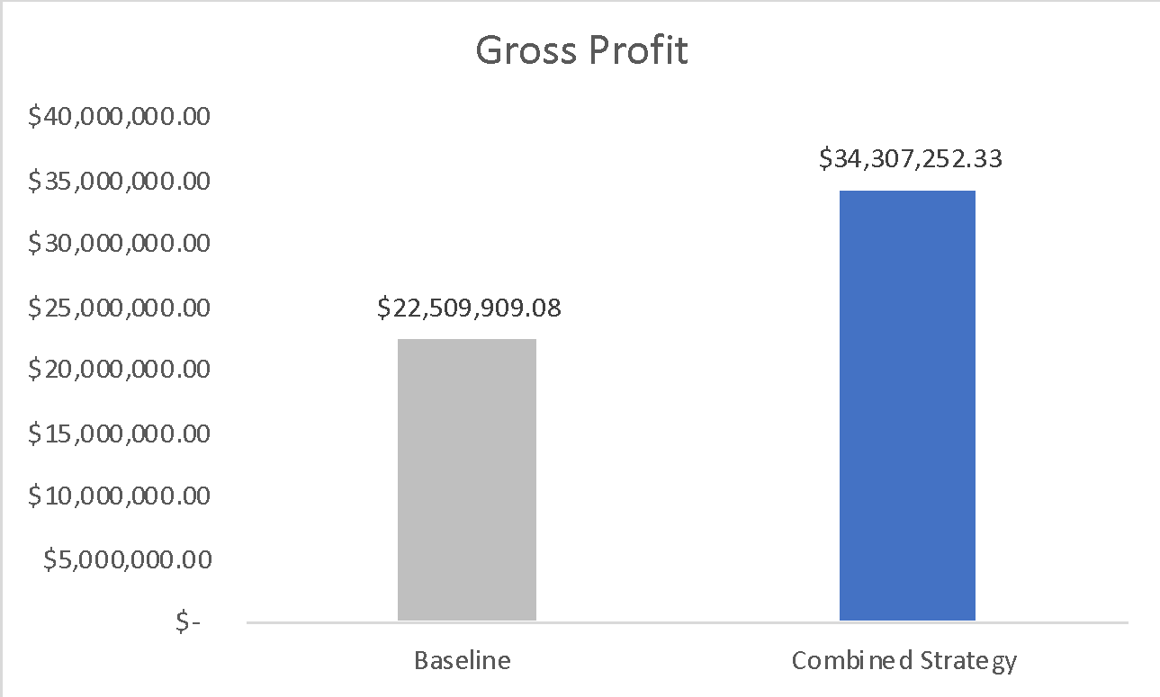
Strategies: Combined Vs. Baseline
Profit Margin 42.61%

Slide 11

Solutions
Combined Strategy
Grow transactions by 25% for top 10 most profitable vehicles by make and model
Add 203 profitable vehicles
Eliminate 10 unprofitable vehicles

